Slide 1
Tailgating Detection
Classy-fiers – IIT Guwahati

Slide 2

Problem Overview
Given CCTV camera footage of a secured door entry, detect anyone tailgating (entry without authorization).

Slide 3

Tailgating Detection Module
Mailing Module
Intruder Identification Module
User Interface
Our Solution
2 solutions:
Mask R-CNN
YOLO-V3
Send mail
Trigger an alarm
Recording and saving the masks and images of intruders.
Developed an Interactive User interface for real-time inference.

Slide 4

Developed Systems:
High Power System:
Model: Mask R-CNN
Tracking: Centroid Tracking
High Efficiency System:
Model: YOLO-v3
Tracking: Deep SORT
This is followed by a common Integrated Alert and Mailing Module.
These approaches will be explained in the following slides.

Slide 5

System 1
- High Power System

Slide 6
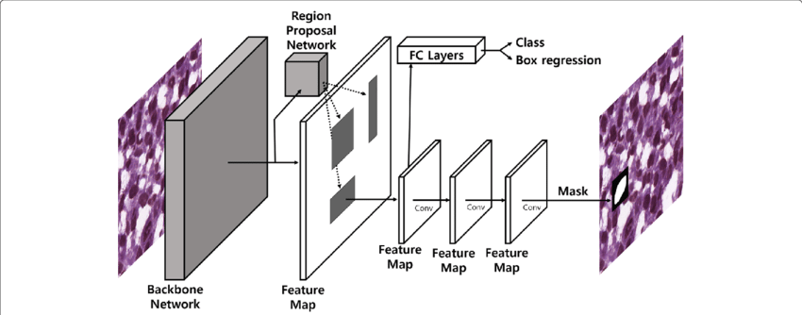
Mask R-CNN
Mask R-CNN is a popular model choice for Instance Segmentation

Slide 7
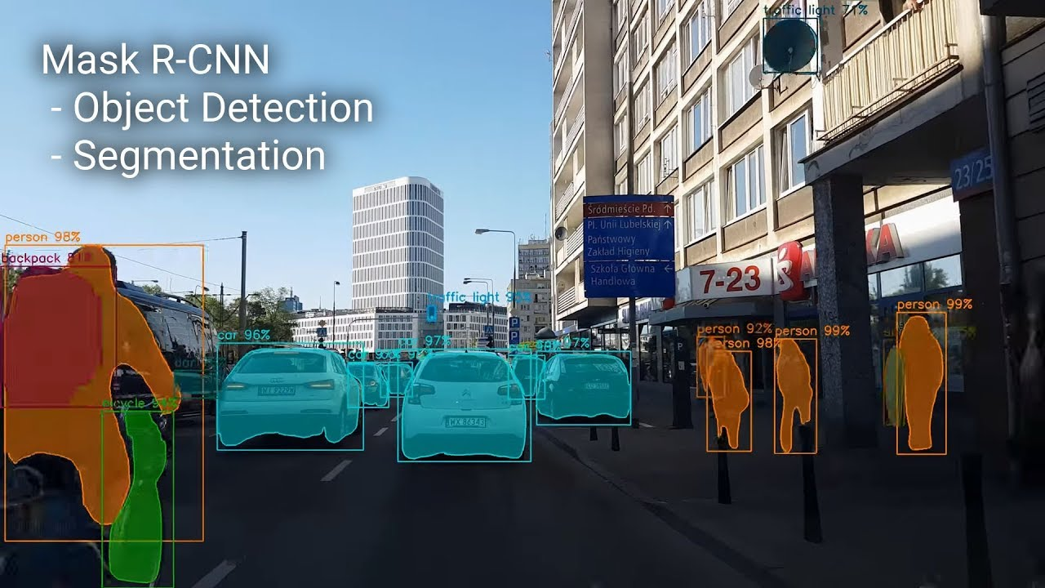

Slide 8
Mask R-CNN based on a Resnet50 backbone
A pre-trained Mask RCNN model is used in our project, as it is very tedious to train this architecture by ourselves based on our current computational capabilities.
The pre-trained weights are trained on the COCO Dataset, which consists of around 91 classes. But for our specific problem, we only need Humans as the class/mask output.
To tackle this problem, we employed Transfer Learning, and finetuned the pre-existing architecture to predict only humans. Transfer Learning was achieved using the Penn Fudan Database, which is a pedestrian dataset. Hence our model now predicts and outputs only humans, thus reducing computation costs significantly.

Slide 9
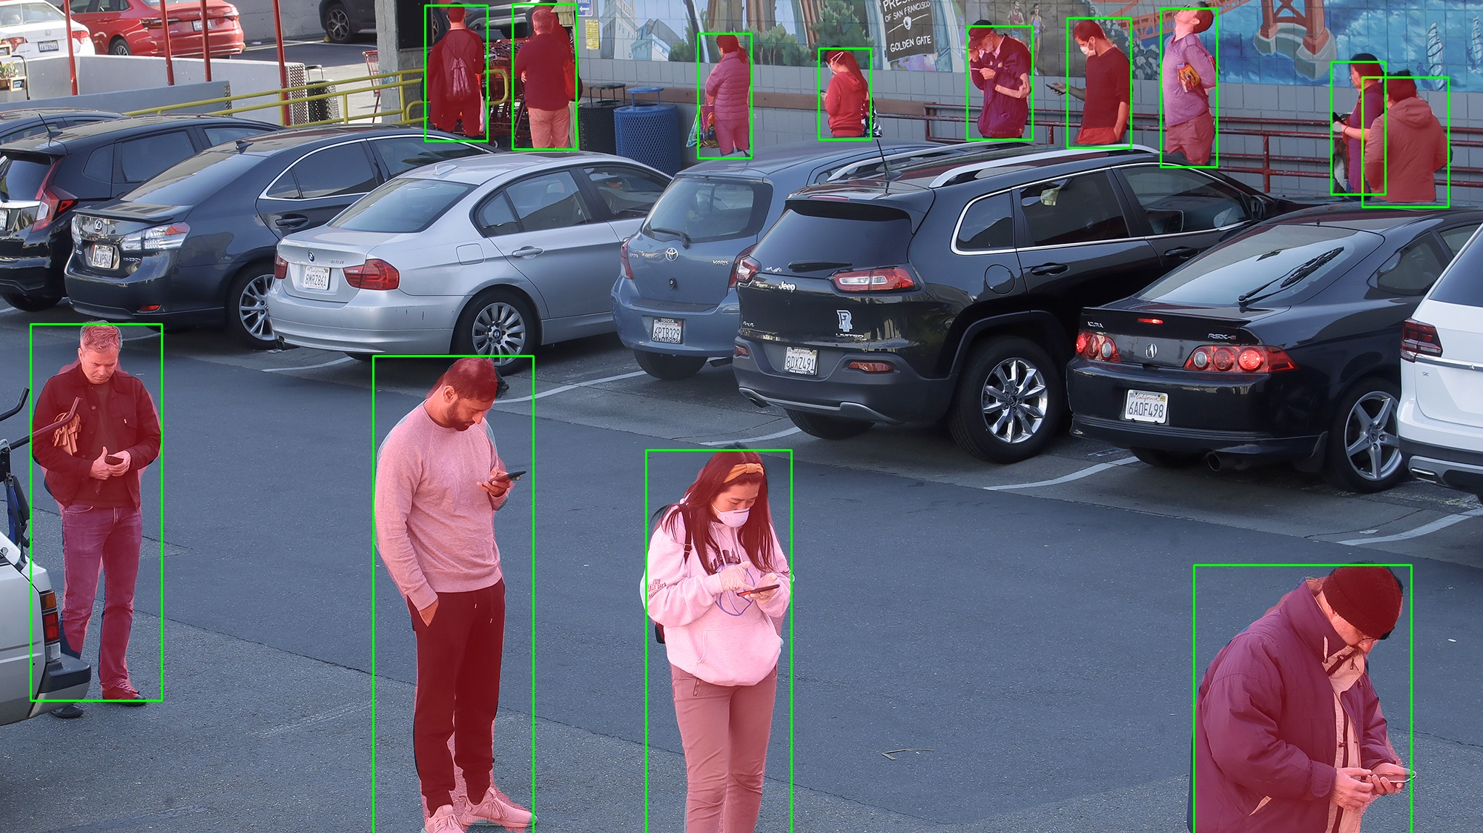
Expected Output

Slide 10
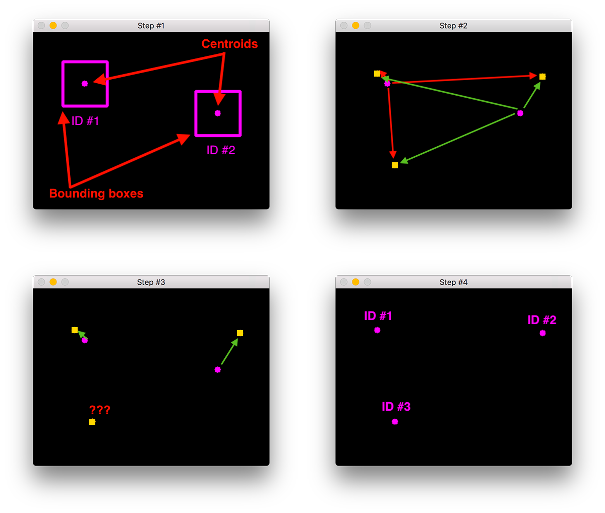
Centroid Tracking
Accept bounding box coordinates and compute centroids
Compute Euclidean distance between new bounding boxes and existing objects
Update (x, y)-coordinates of existing objects
Register new objects
Deregister old objects

Slide 11
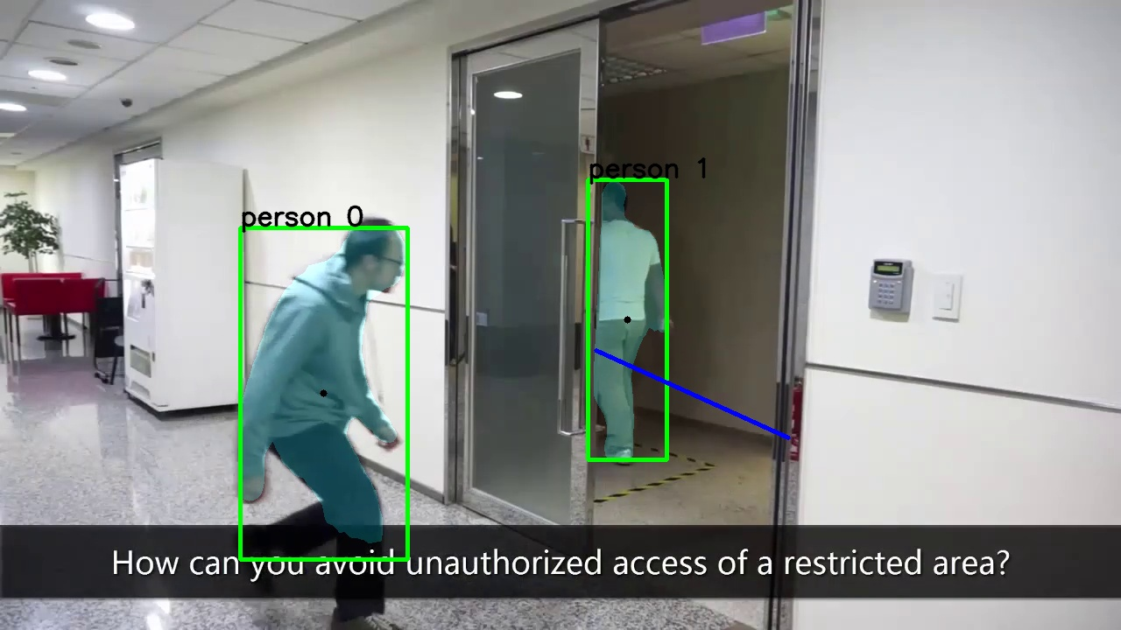
Line of Surveillance

Slide 12
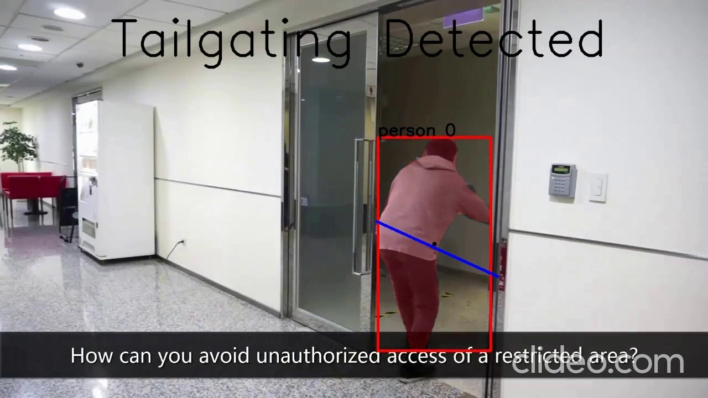
Centroid crossed the line

Slide 13
System 2
- High Efficiency System

Slide 14
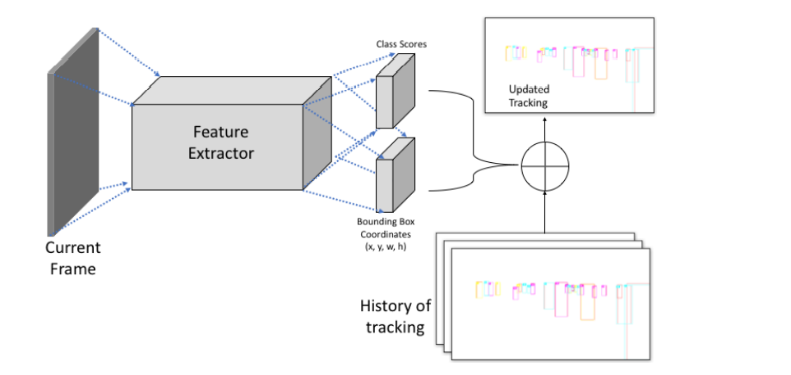
YOLO-v3 + Deep SORT

Slide 15
In the problem setting of Multiple Object Tracking, each frame has more than one object to track. A generic method to solve this has two steps:
Detection: First, all the objects are detected in the frame. There can be single or multiple detections.
Association: Once we have detections for the frame, a matching is performed for similar detections with respect to the previous frame. The matched frames are followed through the sequence to get the tracking for an object
The Deep SORT tracker uses a vector of states to store the historical information for previous detections. If a new frame comes, we can either use pre-stores bounding box detections or compute them using object detection methods. Finally, using current observation of bounding box detections and previous states, the current tracking is estimated

Slide 16
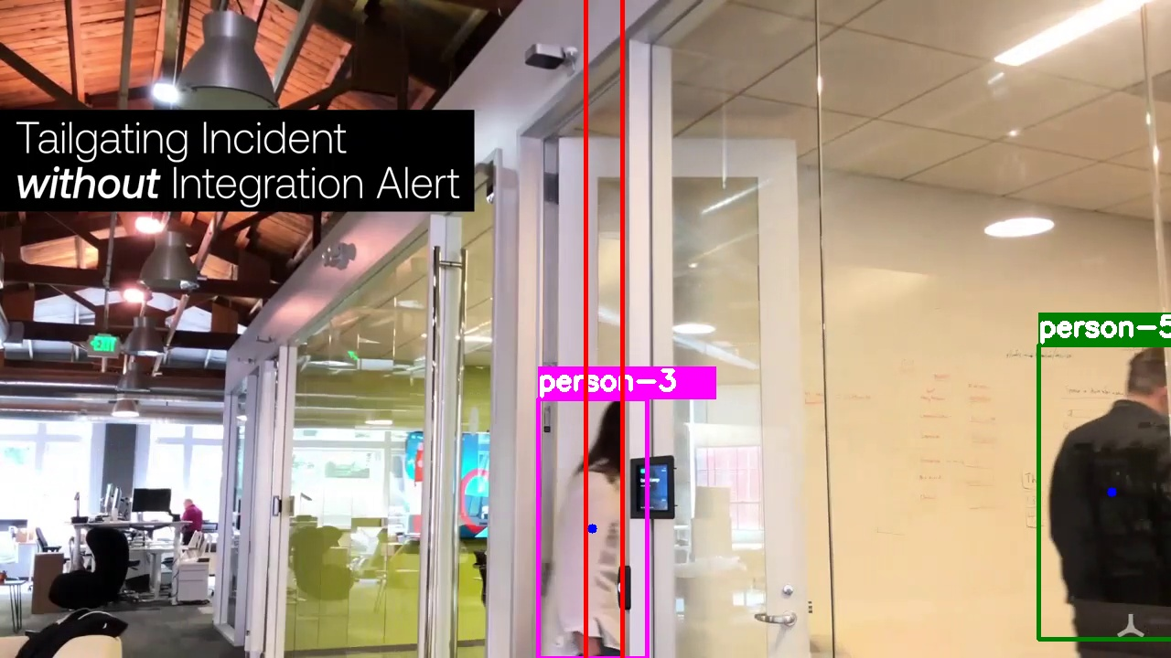
YOLO-v3 Approach
Region of Surveillance

Slide 17
Surveillance Area Logic
In this system, we detect tailgating by counting the number of people crossing the region of surveillance between two consecutive swipes. This is achieved through tracking the respective centroids of the humans detected. Also we take little help from Coordinate Geometry.
Two given points P(x₁, y₁) and Q(x₂, y₂) will lie on the same side of the line ax + by + c = 0 if ax₁+ by₁ + c and ax₂ + by₂ + c will have same signs.
On the other hand, P(x₁, y₁) and Q(x₂, y₂) will lie on the opposite sides of the line ax + by + c = 0 if ax₁ + by₁ + c and ax₂ + by₂ + c will have opposite signs.

Slide 18
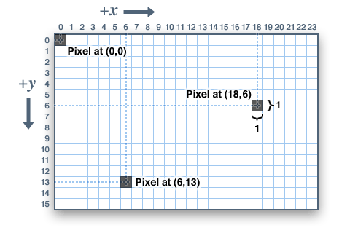
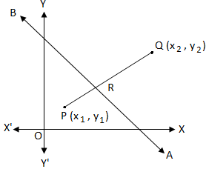
In Python and OpenCV, the origin of a 2D matrix is located at the top left corner starting at x, y= (0, 0). The coordinate system is left-handed where x-axis points positive to the right and y-axis points positive downwards.
Hence, to check if the centroid is between those two lines, we can apply this logic, where one of those two points will be the origin and the other will be the respective centroid.

Slide 19
We have provided the user with two distinct solutions based on their computational capabilities. One approach is an exhaustive end-to-end solution while the other is highly efficient and less computationally expensive.

Slide 20
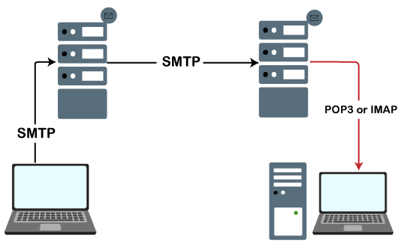
Mailing Module
After detecting an intruder, our main objective is to raise an alarm and alert the security personnel regarding the potential security breach.
This was achieved using SMTP in python. We send a mail to the security department and the person who swiped the card in the first place.
We also trigger a physical alarm, based on the employers need.

Slide 21
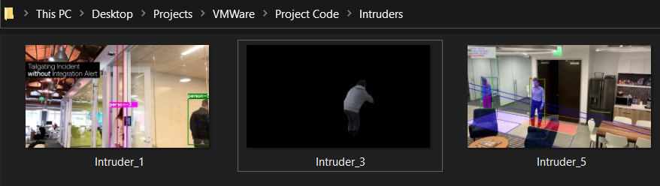
Intruder Identification Module
We maintain a logger file, which would consist of frame/mask of the alleged intruder.

Slide 22
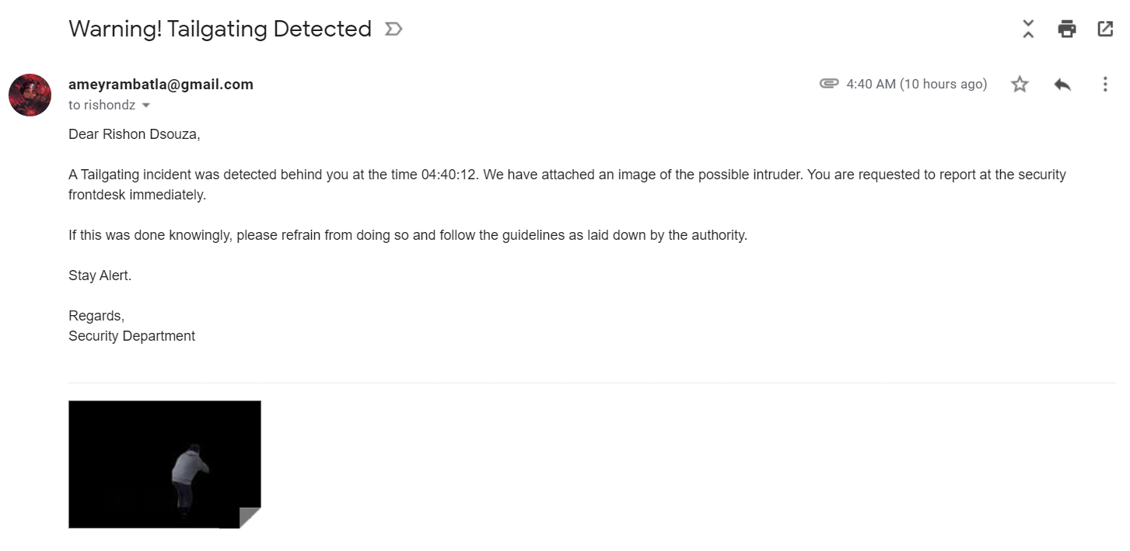
Integrated Alert Module
Swiped Card User
Real-time Alert
Intruder Identification Module

Slide 23
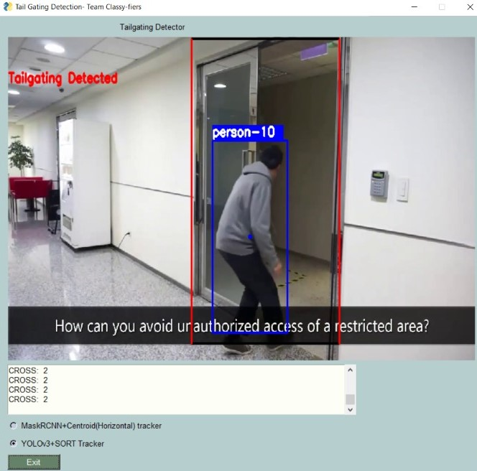
User Interface
Draw Surveillance Region
To provide the user control over this system, we have developed an Interactive GUI, which provides options such as:
Select required System
Draw the line/region of surveillance w.r.t the camera placement.
Logs
Model Selection

Slide 24
Thank You

Slide 25
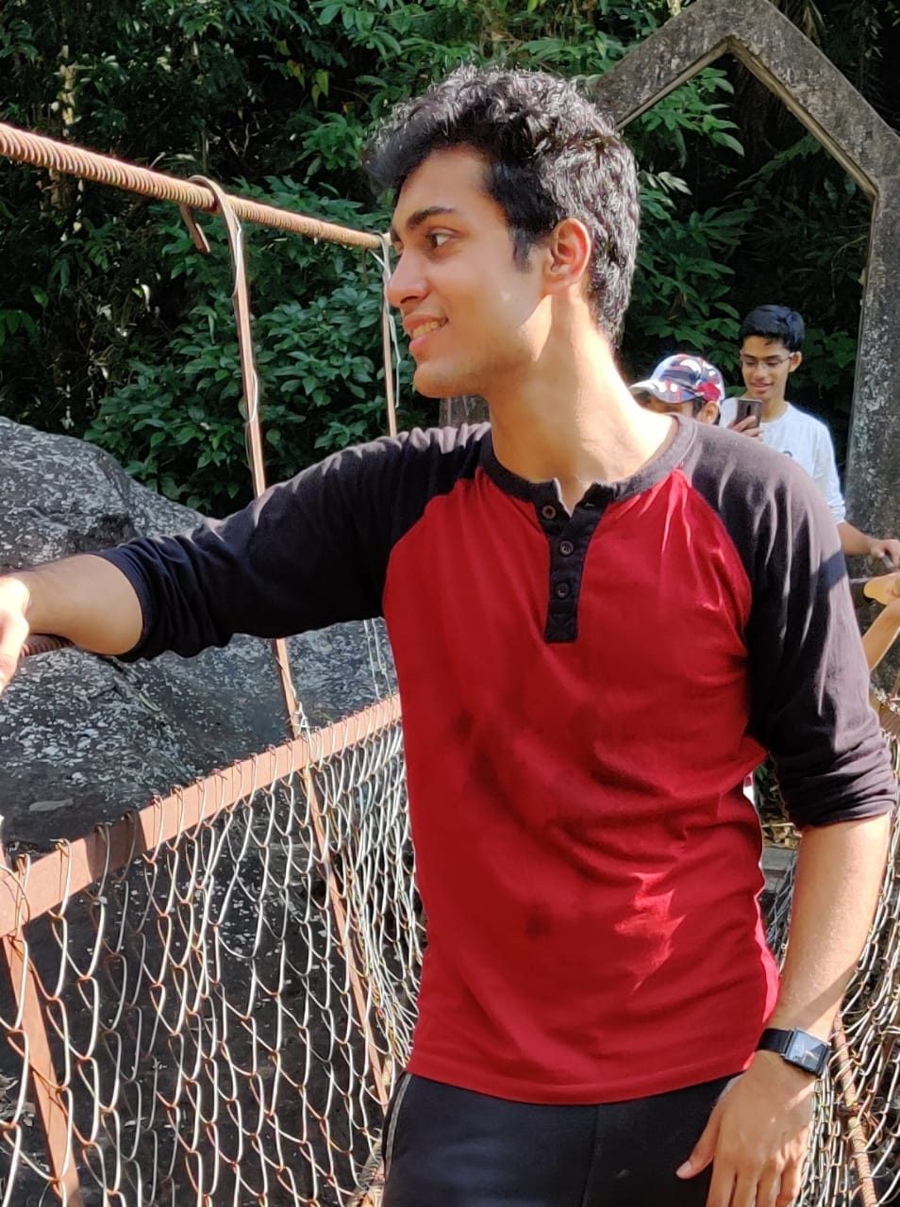
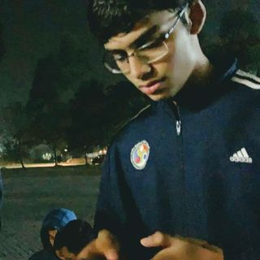
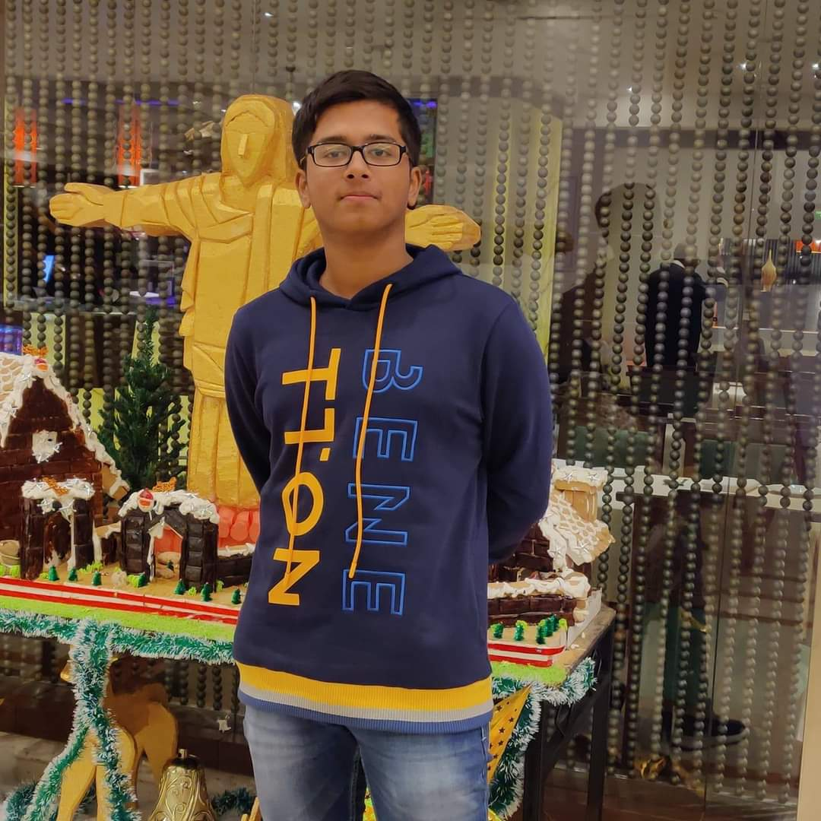
The Team
Rishon Dsouza
Amey Rambatla
Aishik Rakshit

